Slide 1
Implementation and Evaluation of a Software Defined Radio Based Radiometer
Matthew E. Nelson
Iowa State University
Electrical and Computer Engineering

Slide 2
Acknowledgements
POS Committee
Dr. Phillip Jones, Dr. Brian Hornbuckle, Dr. John Basart
Additional Support
Dr. Mani Mina
Special Thanks
My wife Jennifer and my family for their support

Slide 3
Table of Contents
Introduction
Related Works
Background
Radiometer and SDR Basics
Implementation of a SDR-based Radiometer
Experimental Setup and Results
Example Usage Scenario
Closing

Slide 4
Introduction
Introduction
Related Works
Background
Implementation
Experimental Results
Example Usage Scenario
Closing
Presentation goals
Development of a SDR-Based Radiometer
Evaluation of a SDR-Based Radiometer
Benefits of a SDR-Based Radiometer
This thesis looks to explore the following questions:
Can we use a SDR to recreate a radiometer in software?
If so, is the performance similar to a traditional radiometer?
Can we create a low cost SDR-Based Radiometer that is effective?
What benefits do we obtain by using a SDR-Based Radiometer?
Notes:
We will look at how we implemented a SDR-Based Radiometer
We will examine how a SDR-Based Radiometer compares to a traditional radiometer through experimental results
Finally, we will examine benefits of using a SDR-Based Radiometer over a traditional radiometer
By performance, I mean is the sensitivity and stability of a SDR-Based Radiometer comparable to a traditional radiometer

Slide 5
About the thesis
Introduction
Related Works
Background
Implementation
Experimental Results
Example Usage Scenario
Closing
Motivation:
To expand the usage of radiometers
Soil Moisture and Ocean Salinity (SMOS) satellite
Image courtesy of ESA
NRAO VLA
Image courtesy of NRAO/AUI
Notes:
Motivation:
Radiometers are used in a number of applications including: Soil Moisture, Ocean Salinity, and Radio Astronomy.
The Soil Moisture and Ocean Salinity (SMOS) satellite was launched in November 2009 by the European Space Agency (ESA). It measures both soil moisture and ocean salinity using a radiometer at 1.4 GHz using a Microwave Imaging Radiometer with Aperture Synthesis (MIRAS). It uses both Vertical and Horizontal polarization.
Radio Astronomy is another application of radiometers such as the National Radio Astronomy Observatory located in New Mexico. Radio Astronomy can give us information about a variety of celestial objects.
In both cases though, radiometers are typically large and expensive due highly specialized equipment needed. A key point of our research is to used COTS hardware to help reduce the cost and make radiometers more accessible to a broader research communities.
The VLA there uses cryogenics to keep the RXs cool. The signal is digitized and sent via fiber optics to a super computer to process the data.

Slide 6
About the thesis
Introduction
Related Works
Background
Implementation
Experimental Results
Example Usage Scenario
Closing
What is a radiometer?
A radio receiver that measures the average power of the noise coming in within a certain range of frequencies (i.e. bandwidth).
Notes:
A radio receiver used to measure the average power of the noise coming from a radio telescope in a well-defined frequency range is called a radiometer. Noise voltage has zero mean and varies randomly on the very short time scales (nanoseconds) comparable with the inverse bandwidth of the radiometer. A square-law detector in the radiometer squares the input noise voltage to produce an output voltage proportional to the input noise power. Noise power is always greater than zero and usually steady when averaged over much longer times (seconds to hours).

Slide 7
Related Works
Introduction
Related Works
Background
Implementation
Experimental Results
Example Usage Scenario
Closing
Digital Radiometers
Radio Frequency Interference (RFI) Mitigation
Kurtosis
Polarization Signature
Detection
Mitigation
Mechanical Filters
Hybrid
A mix of analog and digital components
Often digitizes after power detection
Direct Sampling
Samples directly at the frequency of interest
Uses digital signal processing to extract power information
Notes:
Three areas of related works – Digital Radiometers, RFI and SDR-based Radiometers.
Protected band – 1400 – 1425 MHz
Digital Radiometers are radiometers that digitize some or all of the incoming signal. A Hybrid radiometer is one that has a mix of analog and digital components and is the common today. However, the digitization is often after power detection and the RF section is often left as an analog system.
A direct Sampling radiometer is very close to a Software Defined Radio. It will directly sample the incoming RF signal. However, it usually does at a sampling rate that does not allow for recreation of the signal, but does allow for the extraction of power information.
RFI Mitigation is an important area of research. Today, there are more RF sources then ever before. Despite the efforts of the international community to protect certain frequencies, interference is still possible and does happen. SMOS for example was plagued with radio interference emanating from Spain.
Because most radiometers do not retain frequency information, detection of interference is done by statistical and probability analysis. The Kurtosis method examines the probability distribution of the total power measurements to determine if the data is skewed which would indicate a an offending signal. Polarization signature examines the difference between the two polarizations of the radiometer. An interfering signal is often a polarized signal and we can see the difference by looking at the difference between the two polarizations.
Mitigation is often done by mechanical filters. These filters are either fixed if the signal is known ahead of time, however there some mechanical filters that can be changed during operation.

Slide 8
Related Works
Introduction
Related Works
Background
Implementation
Experimental Results
Example Usage Scenario
Closing
Software Defined Radio Based Radiometers
Shirleys Bay Radio Astronomy Consortium
Grand Valley State University
Notes:
Marcus is the Principal Investigator at SBRAC and also a contributor to the radiometer branch in GNURadio. SBRAC has successfully used this configuration to obtain radio astronomy data by looking at the hydrogen line at 1420.4058 MHz.
In 2013, the University of Illinois and Grand Valley State University built a software defined radio based radiometer to listen to emissions from Jupiter. The students reported that their SDR based radiometer worked well at a low price point.
One aspect that differentiates the work in the thesis from Grand Valley State University’s work is that they build their own custom hardware for their software defined radio, while in this work off the shelf components were used with an aim of making radiometers more wildly accessible to the research community.
COTS for us was chosen so that radiometers could be used by more people.

Slide 9
Related Works
Introduction
Related Works
Background
Implementation
Experimental Results
Example Usage Scenario
Closing
Contributions
Development of a software defined radio-based radiometer
Python based scripts for analyzing data generated by the radiometer
A Radio Frequency Interference (RFI) mitigation technique implemented using software defined radio technology
Notes:
For our research we have developed a total power radiometer in software. This includes power detection, data smoothing and additional filtering.
Next we generated Python scripts that is able to read the data from our SDR-Based Radiometer and process this information. All graphs used in the thesis and this presentation from our experimental data was processed by these scripts.
Finally we developed a filtering method to filter an offending signal to mitigate RFI affecting our SDR-based Radiometer

Slide 10
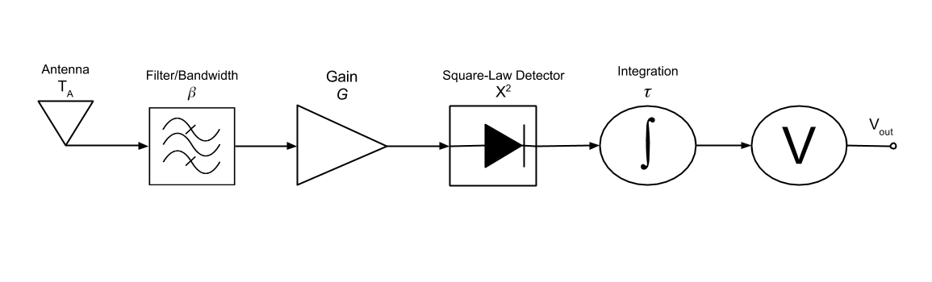
SDR and Radiometer Basics
Introduction
Related Works
Background
Implementation
Experimental Results
Example Usage Scenario
Closing
There are six stages common to all radiometers:
Source
Bandwidth
Amplification
Power detection
Data smoothing
Output
Notes:
A radiometer is a device designed to measure thermal electromagnetic emission by a material media. This electromagnetic emission is the thermal noise of the object and can be correlated to the physical temperature of the object.
An ideal radiometer would only measure this noise temperature. However, a real radiometer has additional noise added.
The protected L-band frequencies are 1400 – 1425 MHz

Slide 11
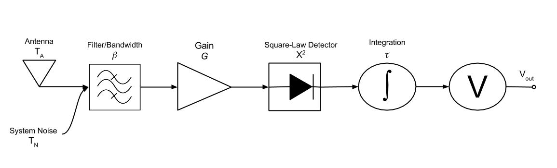
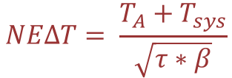
SDR and Radiometer Basics
Introduction
Related Works
Background
Implementation
Experimental Results
Example Usage Scenario
Closing
System Noise
Every device adds noise, even passive devices
The higher the system noise, the lower the sensitivity
The system noise masks the noise of our target
$$NEΔT= \frac{T_{A}+T_{sys}}{\sqrt{τ∗β}}$$
Notes:
Every device adds noise. The amount is related to the physical temperature of the device (hence why cryogenics is used)
Our noise of interest is often very close to our noise floor anyway, If the system noise is too high, it can over power our noise of interest.
System noise is bad…m’kay

Slide 12
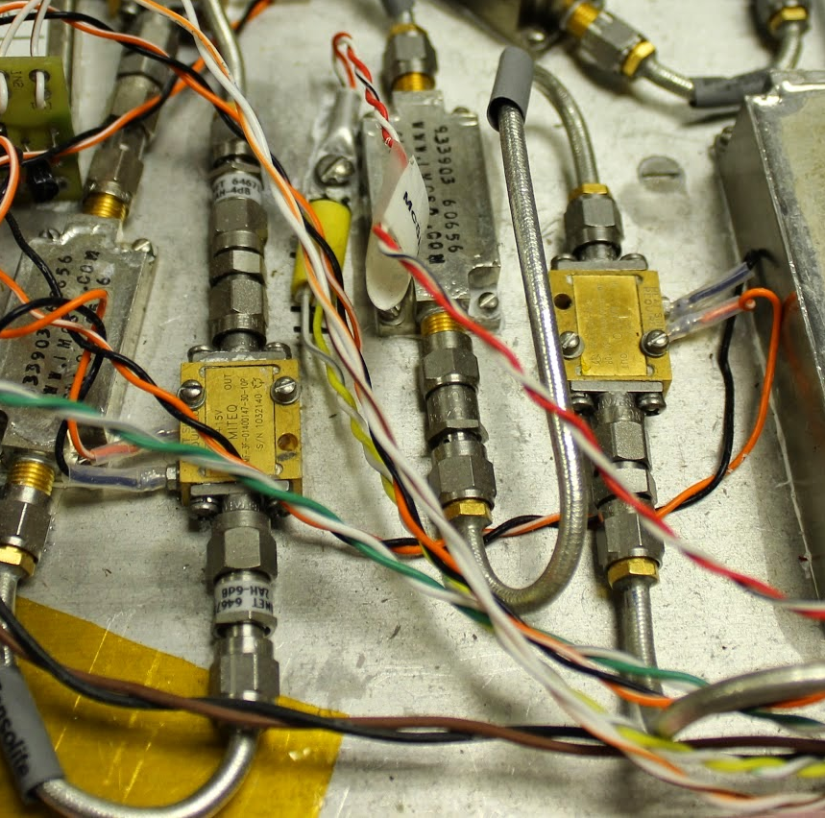
SDR and Radiometer Basics
Introduction
Related Works
Background
Implementation
Experimental Results
Example Usage Scenario
Closing
Power measurement
The key to the performance of a radiometer is to minimize noise generated internally while amplifying the noise generated from the source.
All components generate additional noise
Low Noise Amplifiers (LNAs) are the largest contributors
Notes:
LNAs are used to amplify the noise of interest without adding much of system noise. Typically we see more than one LNA, the first LNA needs to have minimal addition of system noise. The rest can be higher as the impact from them is less. See extra slides on how the NF is affected

Slide 13
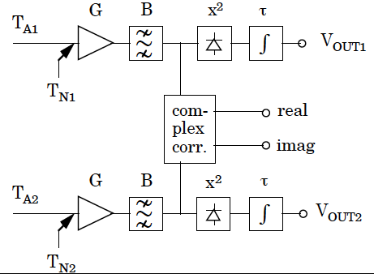
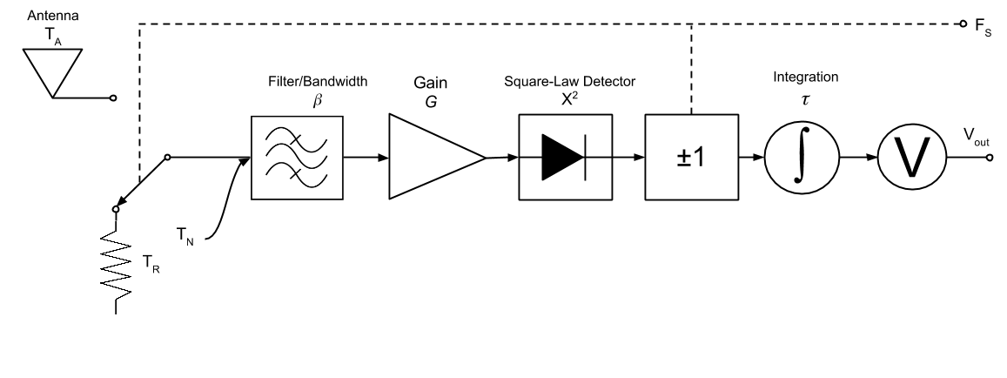
SDR and Radiometer Basics
Introduction
Related Works
Background
Implementation
Experimental Results
Example Usage Scenario
Closing
Radiometer Stability
Control Stability by maintaining physical temperature
Compensate for instability
Dicke Radiometer
Correlating Radiometer
Notes:
Gain Fluctuations happen over large periods of time (i.e. > 1 sec) so we can compensate with Dicke or correlating radiometer
Dicke Radiometer - The total-power receiver is switched between two feeds, one pointing at the source and one displaced by a few beamwidths to avoid the source but measure emission from nearly the same sample of atmosphere. The output of the total-power receiver is multiplied by +1 when the receiver is connected to the on-source feed and by−1 when it is connected to the reference feed. Fluctuations in atmospheric emission and in receiver gain are effectively suppressed for frequencies below the switching rate, which is typically in the range 10 to 1000 Hz.

Slide 14
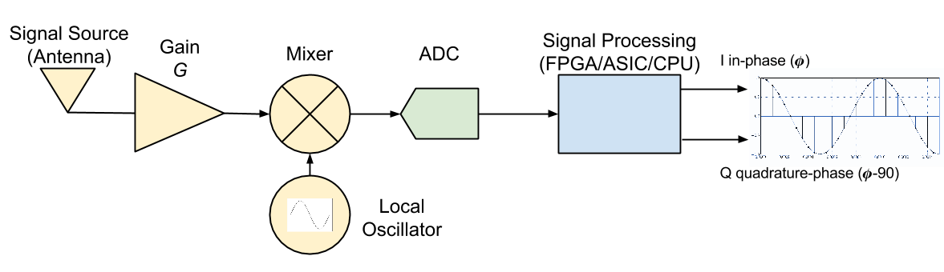
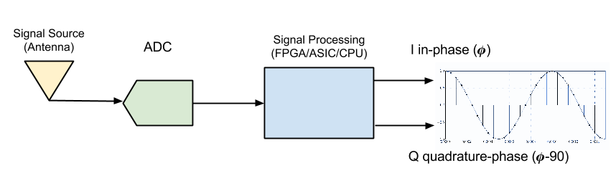
SDR and Radiometer Basics
Introduction
Related Works
Background
Implementation
Experimental Results
Example Usage Scenario
Closing
A software defined radio is a device that digitizes a received RF signal as soon as possible, and processes the digital representation of the signal using digital signal processing
Notes:
A SDR digitizes the signal as soon as possible, ideally immediately after the antenna. However, most practical SDRs require at least some amplification and many will use a mixer to move the very high frequencies ( > 1 GHz) to more managable lower frequencies and to use cheaper and higher quality ADCs.

Slide 15
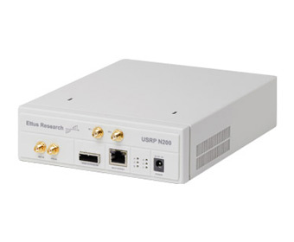
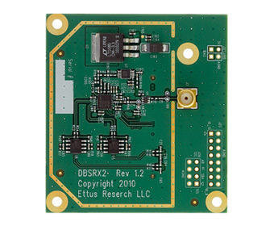
SDR and Radiometer Basics
Introduction
Related Works
Background
Implementation
Experimental Results
Example Usage Scenario
Closing
Hardware Platform
Dual 14-bit ADC
25 MHz bandwidth per channel
Modular daughter-board system
Notes:
Our HW platform is the Ettus Research N200 SDR. This SDR provides us the hardware to digitize an incoming RF signal and process it. It features a 14-bit ADC, 25 MHz BW and a modular daughter-board system. This daughter board system allows us to easily change frequency ranges when needed. It allows up to 2 daughterboards to be plugged in.

Slide 16
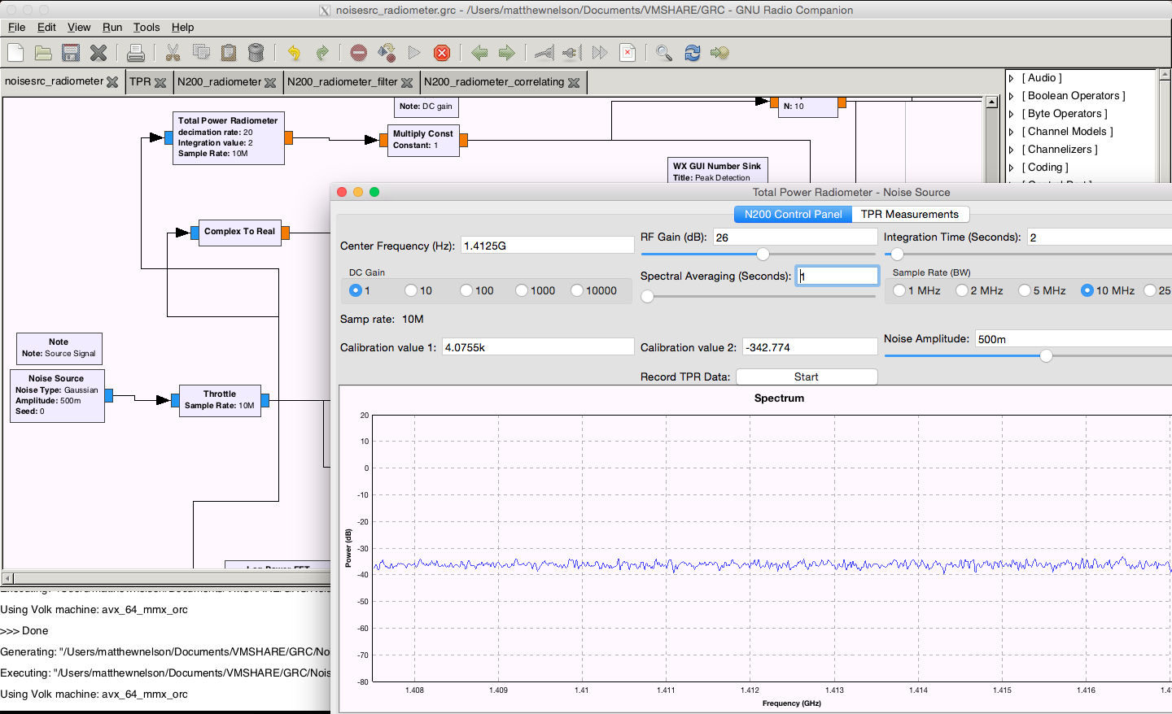
SDR and Radiometer Basics
Introduction
Related Works
Background
Implementation
Experimental Results
Example Usage Scenario
Closing
GNURadio and GNURadio Companion
GNURadio
Open Source
Excellent hardware support
GNURadio Companion
Drag and Drop
Rapid GUI development
Fast and Flexible
Easy to expand
Python/C++
Notes:
For software we used GNURadio which also has a companion software called GRC. GNURadio is fast, flexible and open source. GRC allows us to rapidly develop the SDR-Based Radiometer and also the GUI used to control the SDR-Based Radiometer

Slide 17
SDR-Based Radiometer Implementation
Introduction
Related Works
Background
Implementation
Experimental Results
Example Usage Scenario
Closing
Implementation of a Software Defined Radio Based Radiometer
Hardware Requirements
Software Requirements
Bandwidth 20 MHz
1400 - 1420 MHz
$$NEΔT=1 K$$
𝑁𝐸Δ𝑇=1 𝐾
Easy to use GUI interface for technician to use
Easy to modify
Notes:
To implement our SDR-Based Radiometer, we should first look at the requirements needed.
NEAT is really determined more by the LNAs than the N200
The NEAT was determined by Brian Hornbuckle. However as a comparison the SMOS satellite has a sensitivity of 0.8 to 2.2 Kelvin
While the N200 can do up to 25 MHz, with Ethernet overhead it is more realistic to be at 20 MHz. In addition, there is some limitation on how much the computer can handle. This is very true when storing the data (i.e. limitations on the HDD).

Slide 18
SDR-Based Radiometer Implementation
Introduction
Related Works
Background
Implementation
Experimental Results
Example Usage Scenario
Closing
Mapping traditional radiometer to SDR-Based Radiometer – Power Detection
Analog
SDR
Square the magnitudes
Diode operating in the Square-Law region
Notes:
We begin by looking at power detection. In a traditional radiometer this is done with a diode operating in the square-law region. This results in voltage output that is the square of the voltage in of the signal. To accomplish this in a SDR, we need to remember that a SDR radio takes an incoming signal and measures the magnitude of the signal. This is the in-phase signal generated by the SDR or referred to as I. It then shifts the phase of the signal 90 degrees. This is the quadrature-phase of the signal and is measured by the SDR. Both I and Q is the magnitude of the signal, but Q is shifted by 90 degrees. We can then measure the power by squaring both I and Q and summing them. Just like the square-law detector squares the incoming signal.

Slide 19
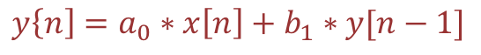
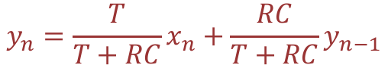
SDR-Based Radiometer Implementation
Introduction
Related Works
Background
Implementation
Experimental Results
Example Usage Scenario
Closing
Mapping traditional radiometer to SDR-Based Radiometer – Data Smoothing
$$y\left\{n\right]=a_{0}∗x\left[n\right]+b_{1}∗y[n−1]$$
$$y_{n}=\frac{T}{T+RC}x_{n}+\frac{RC}{T+RC}y_{n−1}$$
Analog
SDR
Infinite Impulse Response Filter
Integrator a.k.a. Low Pass Filter
Notes:
IIR filter
Decimation to reduce data size

Slide 20
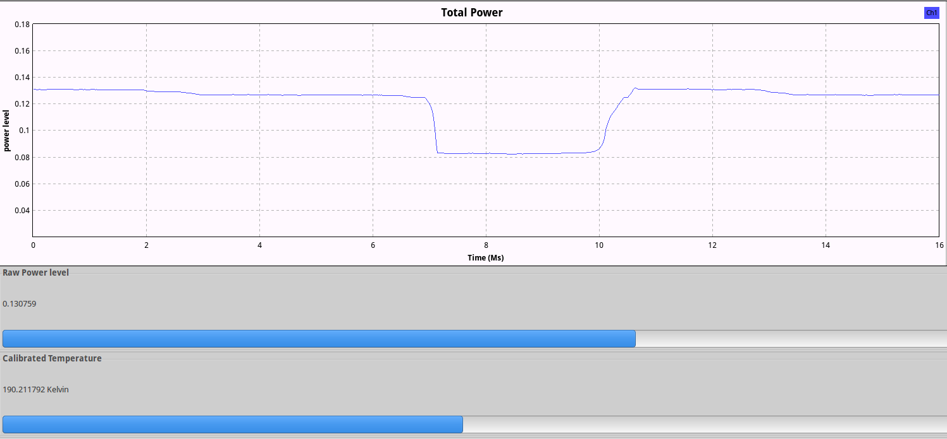
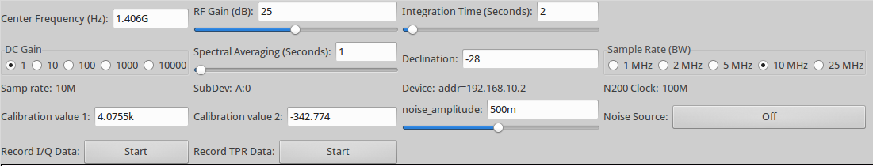
SDR-Based Radiometer Implementation
Introduction
Related Works
Background
Implementation
Experimental Results
Example Usage Scenario
Closing
SDR-Based Radiometer Graphical User Interface
Hardware Control
Data Display
Center Frequency
Bandwidth
Integration time
Raw total power
Calibrated noise temperature
Spectrum
Filtering
Notes:
Here we can see the GUI. Talk about the GUI
Next we will examine the experimental data collected from our SDR-Based Radiometer

Slide 21
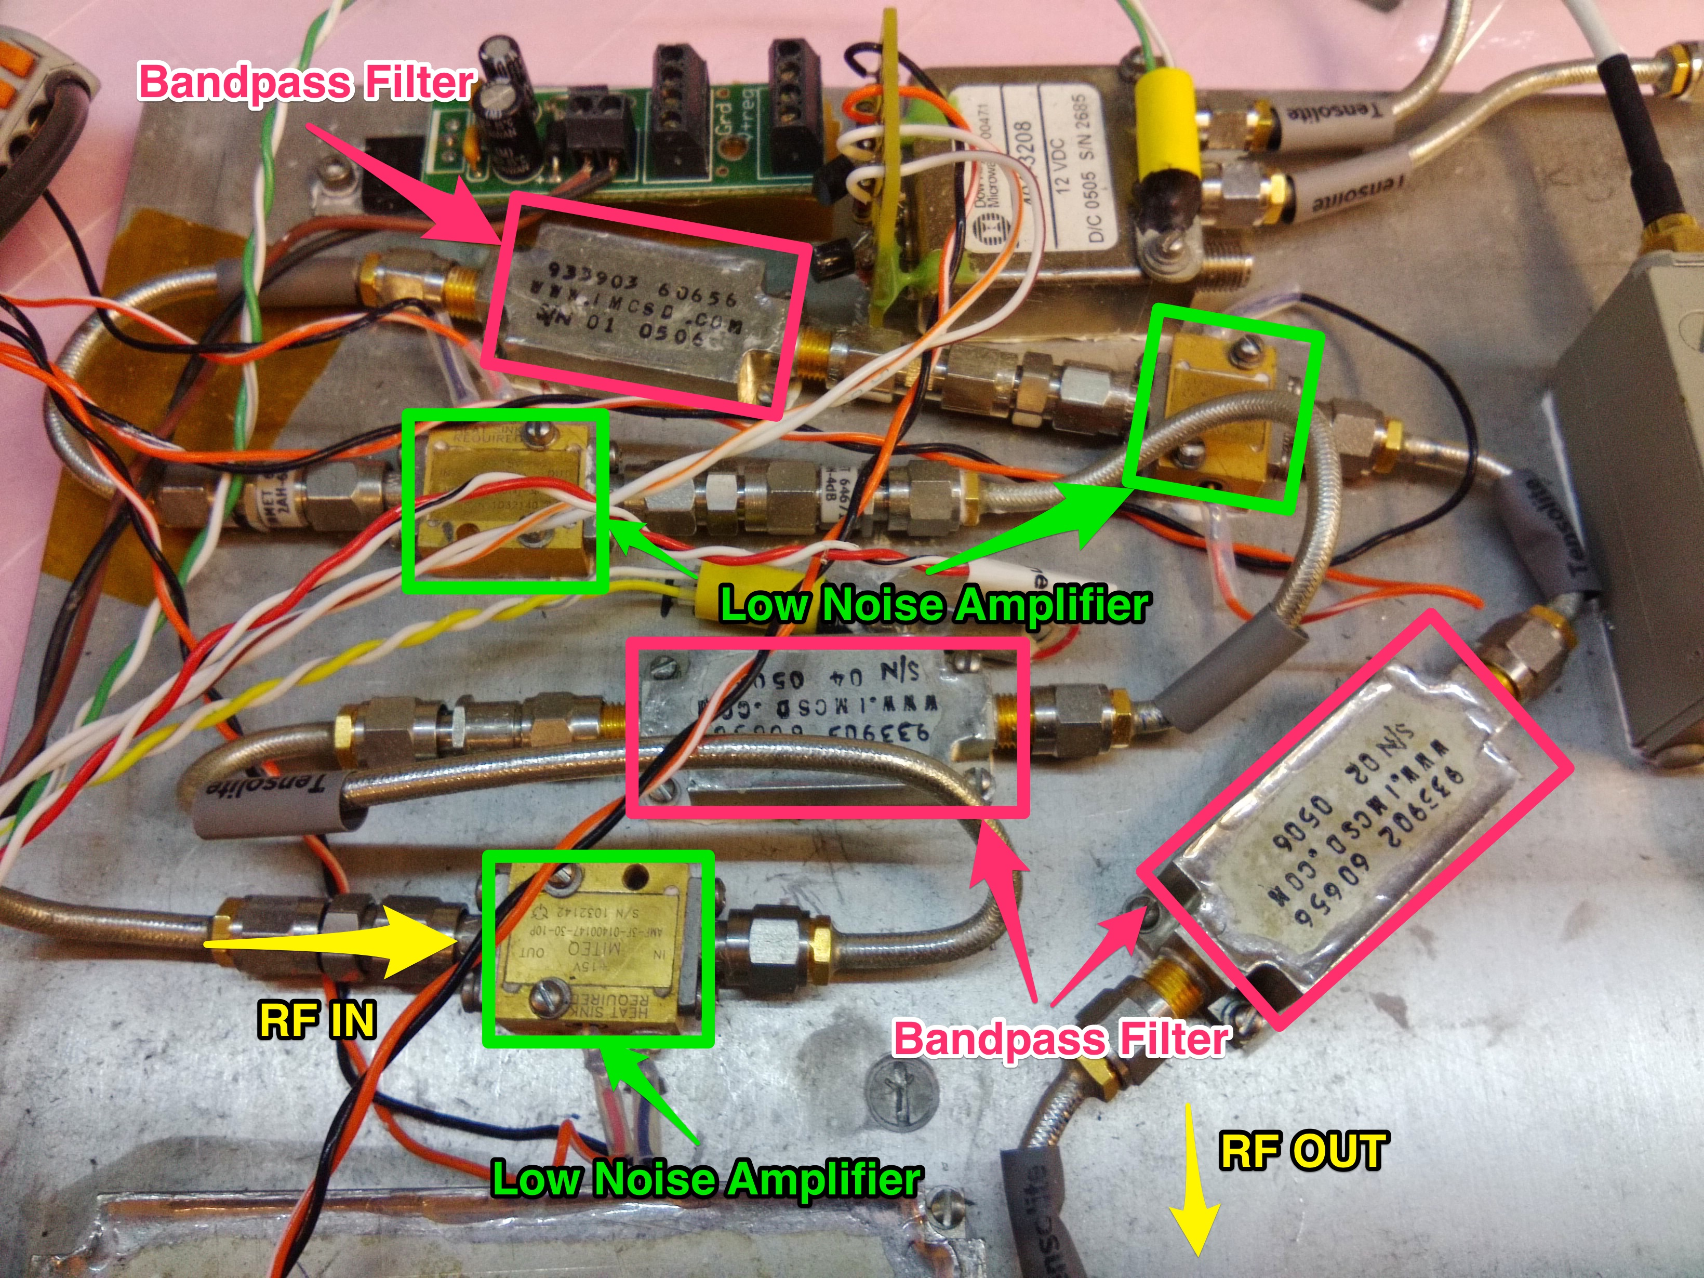
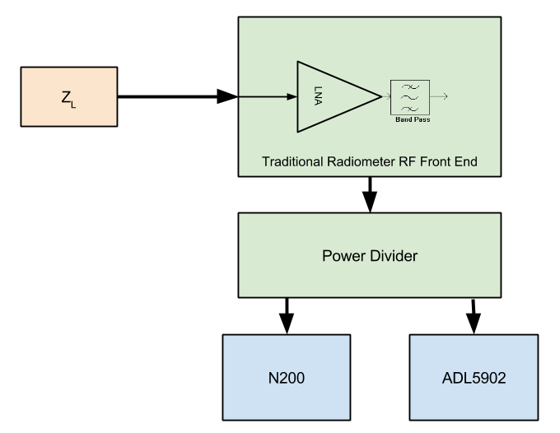
Experimental Results
Introduction
Related Works
Background
Implementation
Experimental Results
Example Usage Scenario
Closing
Experiment 1 – SDR-Based Radiometer Verification and Calibration
Setup
N200 SDR
ADL5902 - Square-law detector
Power Divider
Traditional Radiometer RF Front End
Matched Load
Data Collection
GNURadio
Labview with ADC
Notes:
Experiment 1 was conducted to verify that we are able to calibrate our SDR-Based Radiometer. It will also show that our SDR-Based Radiometer has the same type of operation as a traditional radiometer.

Slide 22
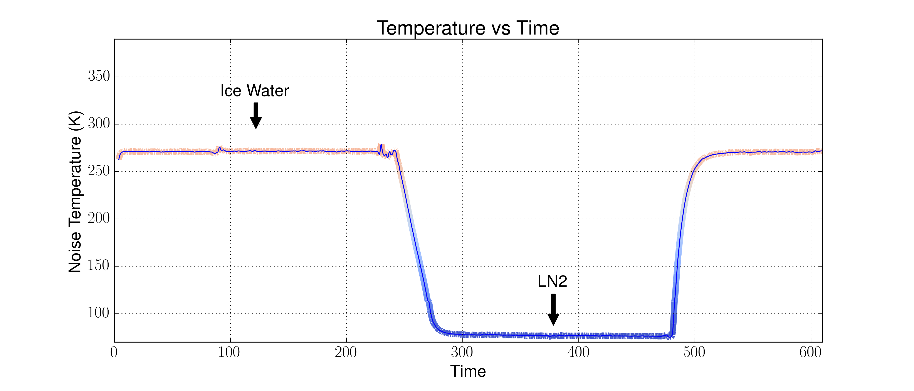
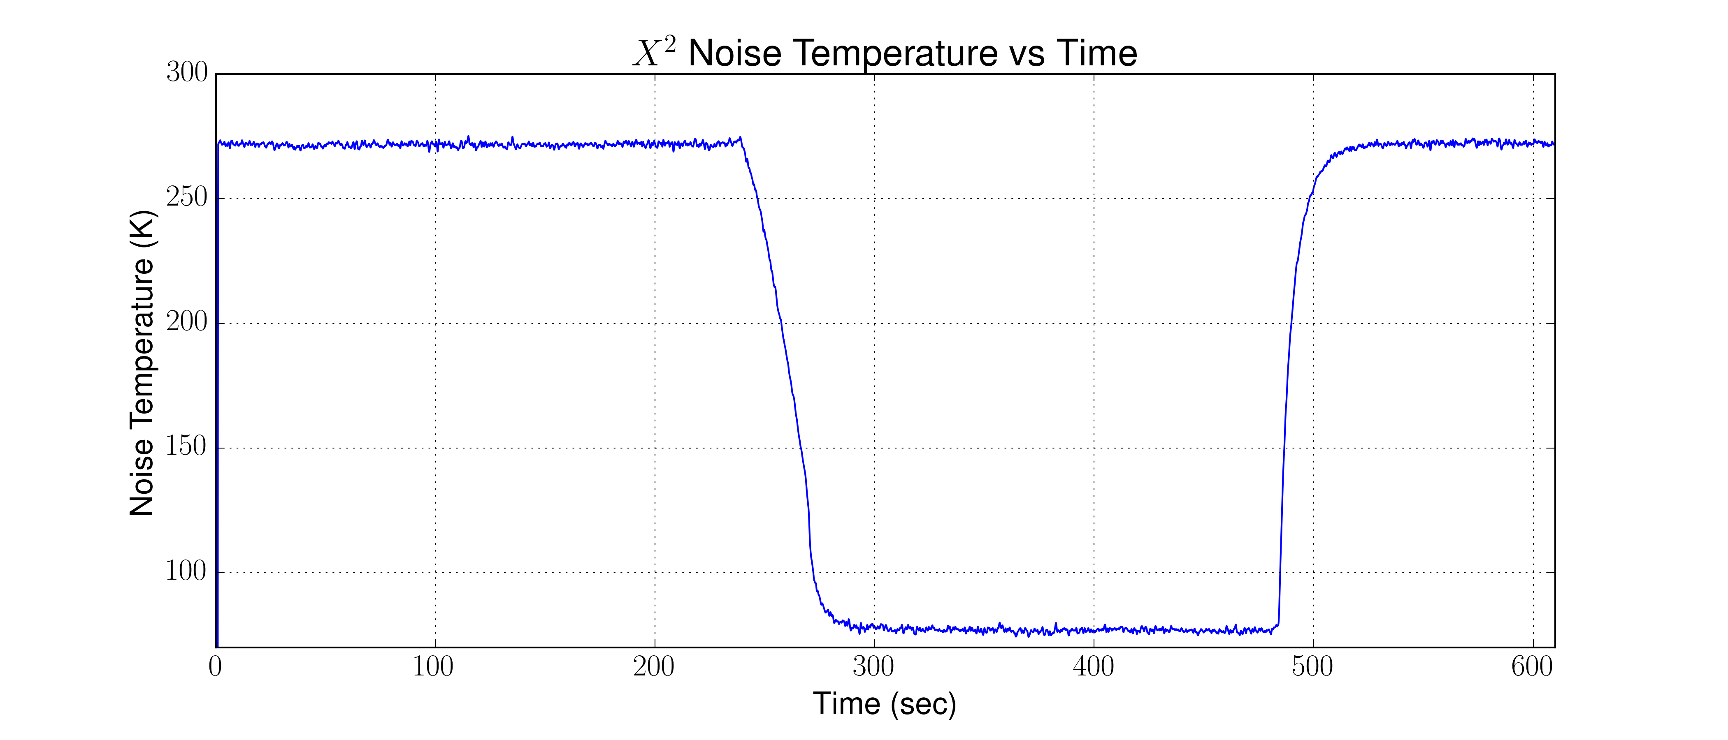
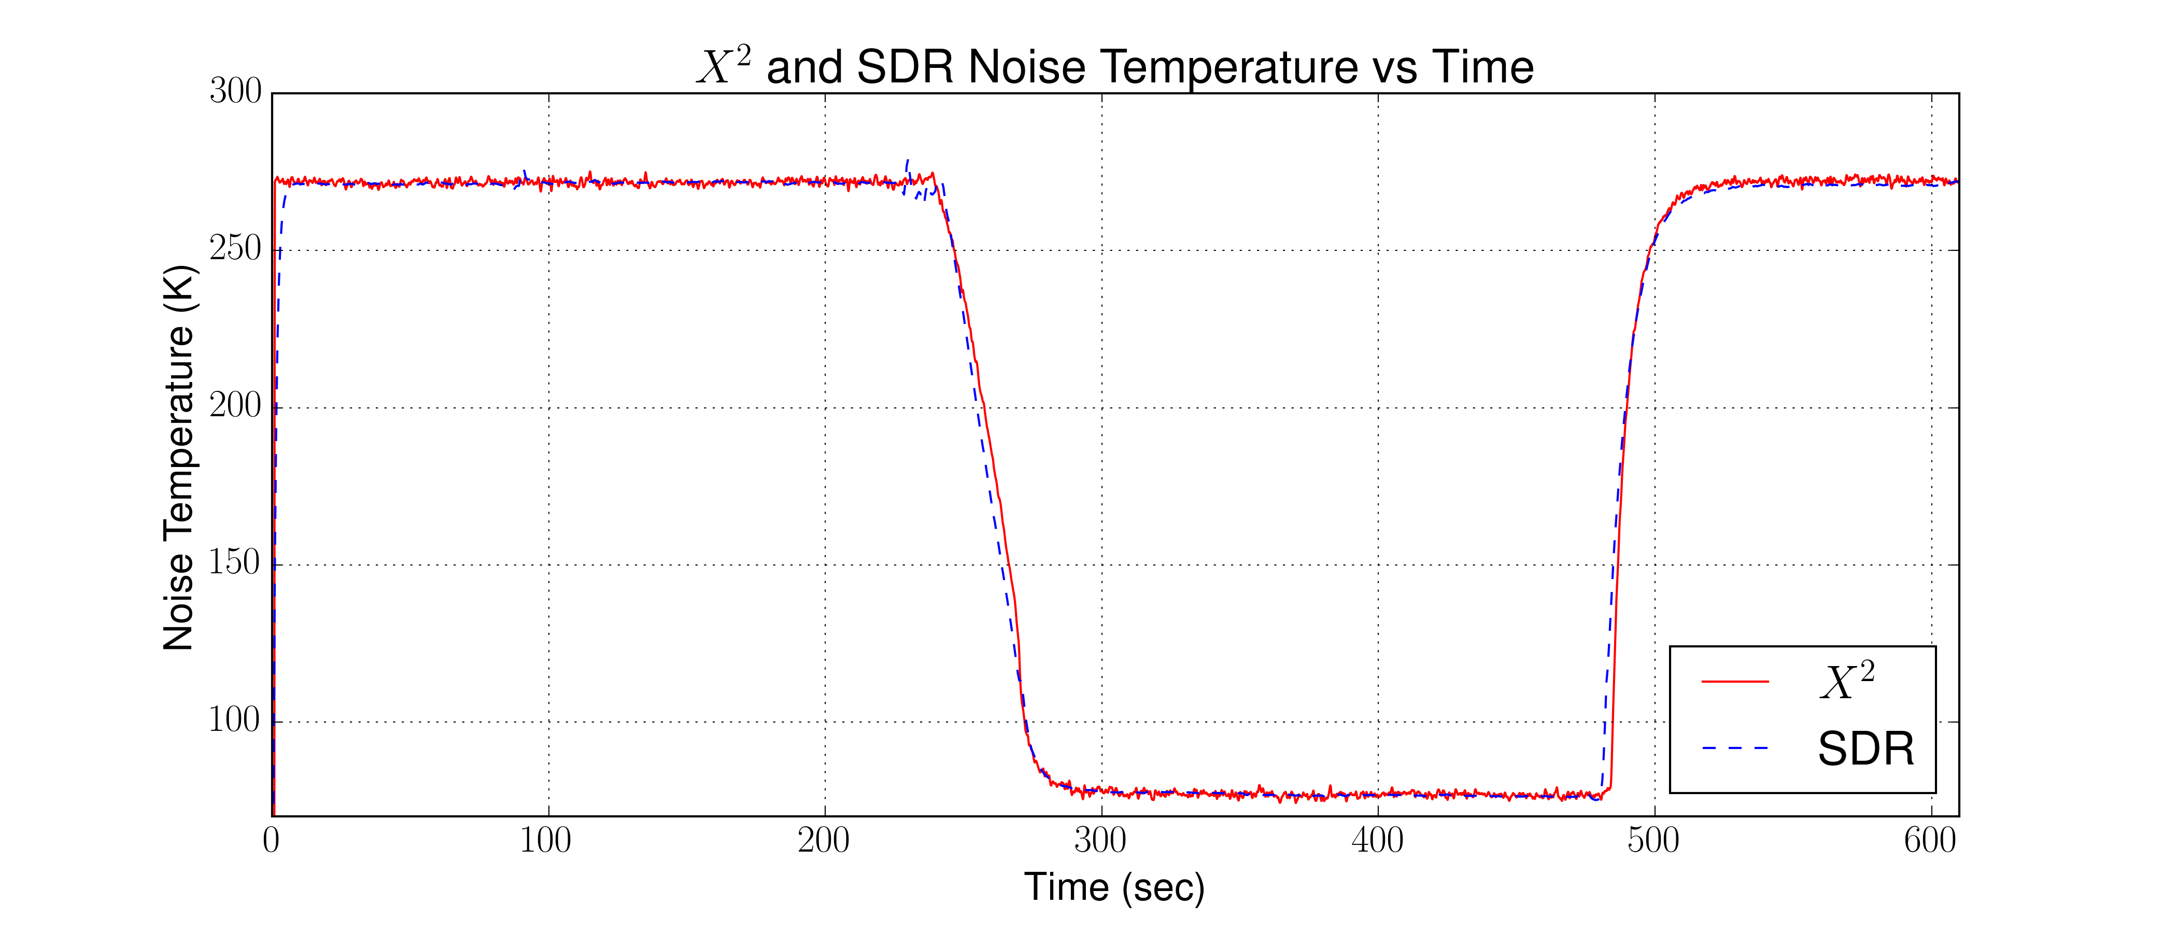
Experimental Results
Introduction
Related Works
Background
Implementation
Experimental Results
Example Usage Scenario
Closing
Experiment 1 – SDR-Based Radiometer Verification and Calibration
Results
Successfully calibrated both the square-law detector and the SDR-Based Radiometer. The square-law and SDR-Based Radiometer agree within .002 Kelvin
Square-law Detector
Square-law and SDR-Based Radiometer
SDR-Based Radiometer
Notes:
Both agree within .002 in Ice, even better in LN2 with .0003 Kelvin

Slide 23
Experimental Results
Introduction
Related Works
Background
Implementation
Experimental Results
Example Usage Scenario
Closing
Experiment 2 – Sensitivity and Stability
Setup
Identical Setup to Experiment 1
Notes:
Experiment 2 is designed to look at the sensitivity and stability of the SDR-Based Radiometer

Slide 24
Experimental Results
Introduction
Related Works
Background
Implementation
Experimental Results
Example Usage Scenario
Closing
Experiment 2 – Sensitivity and Stability
Results
SDR-Based Radiometer met expected sensitivity and stability performance metrics
Sensitivity
Expected - .1 Kelvin
Measured - .23 Kelvin
Stability
Stayed within ~ +/- .15 Kelvin over 15 min. period
Notes:
This experiment was designed to verify that the SDR-Based Radiometer had similar performance to a traditional radiometer
Factors not considered in our NEAT is additional noise from the SDR such as from the PGA and Mixer, and quantization noise from the A/D. Finally, while we assumed a stable radiometer it is possible some fluctuations in temperature still occurred.

Slide 25
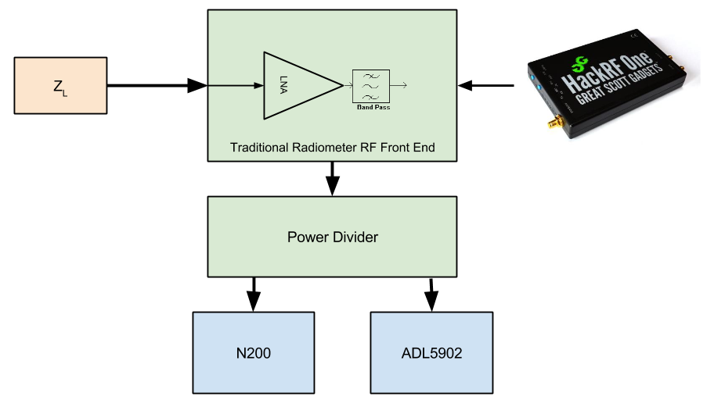
Experimental Results
Introduction
Related Works
Background
Implementation
Experimental Results
Example Usage Scenario
Closing
Experiment 3 – Interfering Signal Mitigation
Setup
Identical to Experiment 1 except an interfering signal is injected
Notes:
Experiment 3 is designed to see if we can detect and mitigate an interfering signal. The HackRF One is a SDR, but with less specs than the N200. It is used to generate a sine wave at 1.406 GHz and that signal is injected to the radiometer

Slide 26
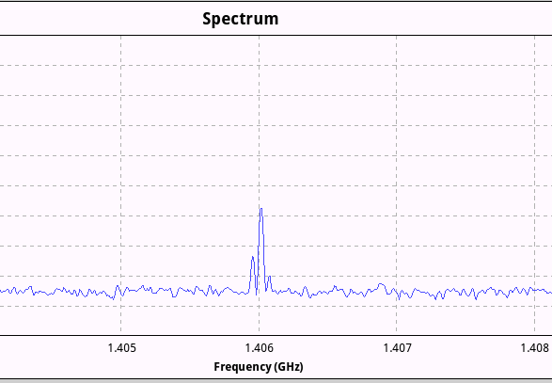
Experimental Results
Introduction
Related Works
Background
Implementation
Experimental Results
Example Usage Scenario
Closing
Experiment 3 – Interfering Signal Mitigation
Results
SDR-Based Radiometer was able to successfully mitigate the interfering signal
Offending signal filtered
Total power measurements made
SDR-Based Radiometer
Analog Square-Law
Interfering signal identified
Notes:
Here we changed the power of the interfering signal so we can see the change in both the square law and the SDR. With the SDR however, we have frequency information. So we can easily see the interfering signal.

Slide 27
Experimental Results
Introduction
Related Works
Background
Implementation
Experimental Results
Example Usage Scenario
Closing
Experiment 4 – Performance impact of interfering signal mitigation
Setup
Identical to Experiment 3
Notes:
In Experiment 4, we examine the impact that filtering the signal causes.

Slide 28
Experimental Results
Introduction
Related Works
Background
Implementation
Experimental Results
Example Usage Scenario
Closing
Experiment 4 – Interfering Signal Mitigation
Results
SDR-Based Radiometer was able to successfully mitigate the interfering signal
Total Power output vs bandwidth of signal
$$NEΔT vs Bandwidth (β)$$
𝑁𝐸Δ𝑇 𝑣𝑠 𝐵𝑎𝑛𝑑𝑤𝑖𝑑𝑡ℎ (𝛽)
Notes:
The impact of filtering the signal can be seen here. We looked at both calculated and experimental results. The Std. Deviation was calculated over a period of 10 seconds.
We can also see the total power output from the radiometer as we reduce the bandwidth. As expected as the bandwidth decreases the total power decreases.

Slide 29
Example Usage Scenario
Introduction
Related Works
Background
Implementation
Experimental Results
Example Usage Scenario
Closing
Application Scenario: Soil Moisture reading with interfering signal
A radiometer is deployed in a field to take soil moisture readings
Data is recorded with the SDR-based radiometer. Both total power and the I and Q data is saved
After the experiment, the data is examined. The data is inconsistent and indicates a problem. Further analysis is needed
Notes:
Usage Scenario
Radiometer is deployed and the data is recorded. We then see in the total power measurements that something is off. Further analysis shows an interfering signal.

Slide 30
Example Usage Scenario
Introduction
Related Works
Background
Implementation
Experimental Results
Example Usage Scenario
Closing
The I/Q data is played back and examined on the spectrum analyzer window of our program. An interfering signal can clearly be seen at 1.406 GHz
A filter is designed in GNURadio to notch out the offending signal
Notes:
The interfering signal can clearly be seen in our spectrum view. We can now design a filter to notch it out.

Slide 31
Example Usage Scenario
Introduction
Related Works
Background
Implementation
Experimental Results
Example Usage Scenario
Closing
The data needs to be re-calibrated since we have lost some bandwidth to the filter
The experiment is played back through GNURadio but with the filter turned on
New total power measurements are then made resulting in the correct data obtained
Notes:
We can now notch out the signal. However, we have now lost some bandwidth, so we need to re-calibrate the radiometer. Now we can re-run the experiment and get our data.

Slide 32
Closing
Introduction
Related Works
Background
Implementation
Experimental Results
Example Usage Scenario
Closing
In Closing
A SDR-Based Radiometer using off the shelf components is able to perform comparable to a traditional radiometer
Within .02 Kelvin
Within .13 Kelvin in expected sensitivity
Additional functionality can be added in software to add features
RFI Mitigation

Slide 33
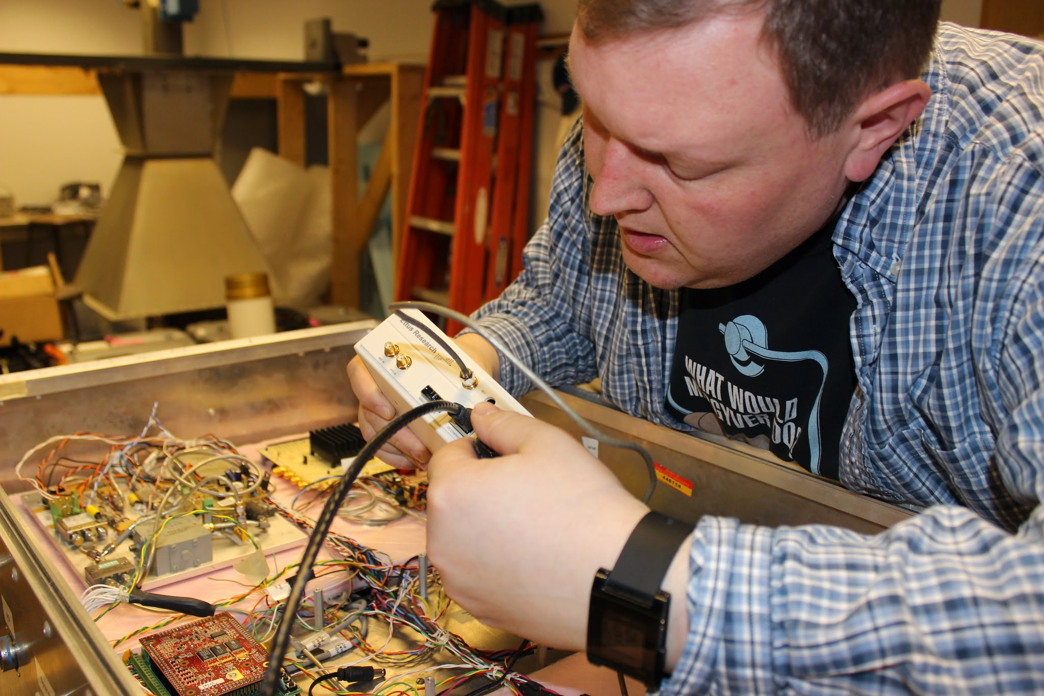
Closing
Introduction
Related Works
Background
Implementation
Experimental Results
Example Usage Scenario
Closing
Thank you

Slide 34
Extra Slides
Introduction
Related Works
Background
Implementation
Experimental Results
Example Usage Scenario
Closing
Cost and Weight Table
Device | Cost | Weight
N200 | $1,515 | 1.2 kg
DBSRX2 Daughterboard | $152 | .1 kg
LNAs | ~$200 | .09 kg
GNURadio | $0 | 0 kg
Total | $1,867 | 1.39 kg
ISU Radiometer | ~ $10,000 | 22.7 kg
Spectracyber | $2,650 | 6 kg

Slide 35
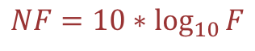
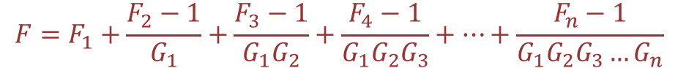

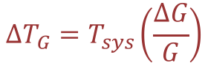

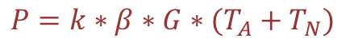
Extra Slides
Introduction
Related Works
Background
Implementation
Experimental Results
Example Usage Scenario
Closing
Equations - Radiometer
$$P=k∗β∗G∗(T_{A}+T_{N})$$
$$NF=10∗\log_{10}{F}$$
$$F=F_{1}+\frac{F_{2}−1}{G_{1}}+\frac{F_{3}−1}{G_{1}G_{2}}+\frac{F_{4}−1}{G_{1}G_{2}G_{3}}+…+\frac{F_{n}−1}{G_{1}G_{2}G_{3}…G_{n}}$$
$$NEΔT= \frac{T_{A}+T_{sys}}{\sqrt{τ∗β}}$$
$$ΔT_{G}=T_{sys}\left(\frac{ΔG}{G}\right)$$
$$V_{out}=nV_{in}^{2}=nP_{in}$$

Slide 36
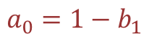
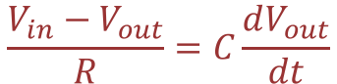
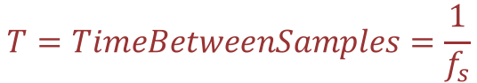
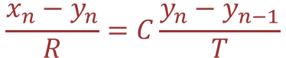

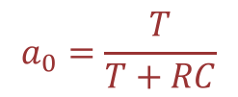
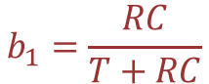
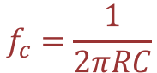
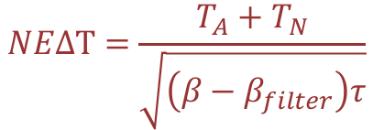
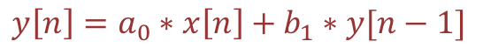
Extra Slides
Introduction
Related Works
Background
Implementation
Experimental Results
Example Usage Scenario
Closing
Filtering
$$\frac{V_{in}−V_{out}}{R}=C\frac{dV_{out}}{dt}$$
$$y\left[n\right]=a_{0}∗x\left[n\right]+b_{1}∗y[n−1]$$
$$\frac{x_{n}−y_{n}}{R}=C\frac{y_{n}−y_{n−1}}{T}$$
$$T=TimeBetweenSamples=\frac{1}{f_{s}}$$
$$a_{0}=1−b_{1}$$
$$a_{0}=\frac{T}{T+RC}$$
$$y_{n}=\frac{T}{T+RC}x_{n}+\frac{RC}{T+RC}y_{n−1}$$
$$b_{1}=\frac{RC}{T+RC}$$
$$NEΔT=\frac{T_{A}+T_{N}}{\sqrt{\left(β−β_{filter}\right)τ}}$$
$$f_{c}=\frac{1}{2πRC}$$

Slide 37
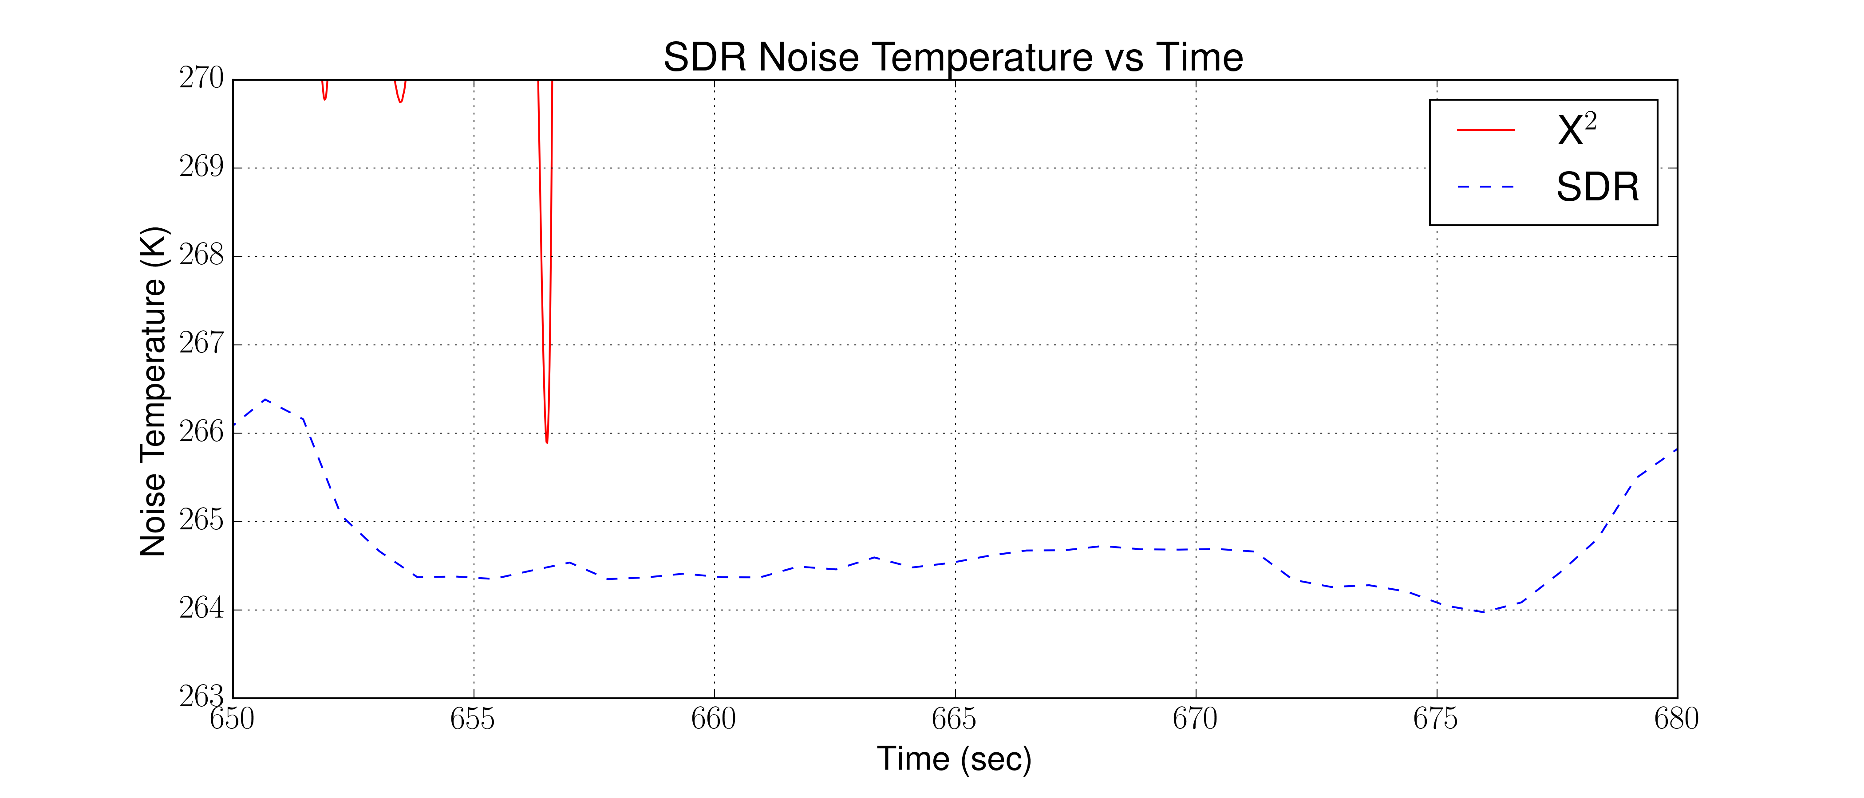
Extra Slides
Introduction
Related Works
Background
Implementation
Experimental Results
Example Usage Scenario
Closing
Filter Fluctuations

Slide 38
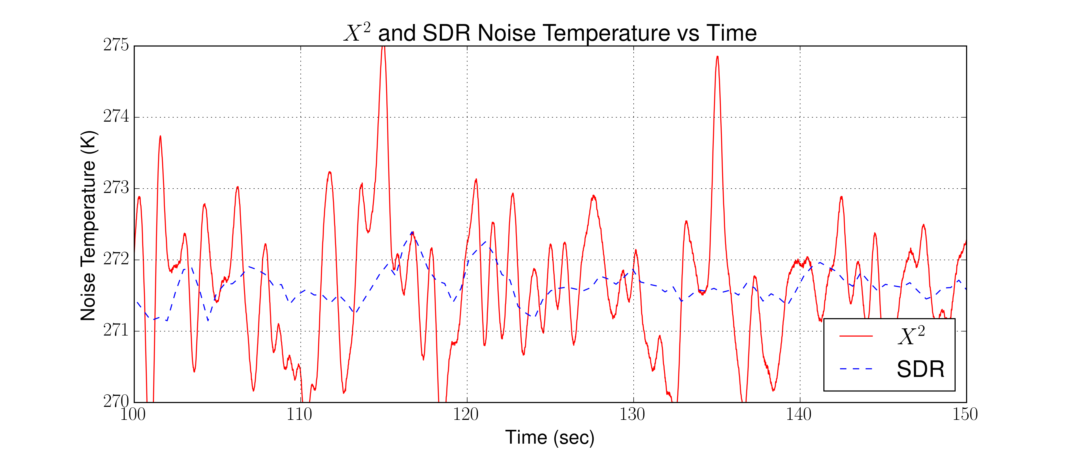
Extra Slides
Introduction
Related Works
Background
Implementation
Experimental Results
Example Usage Scenario
Closing
Difference between X² and SDR
In LN2 ~ .0003 Kelvin. | In Ice, ~ .002 Kelvin

Slide 39
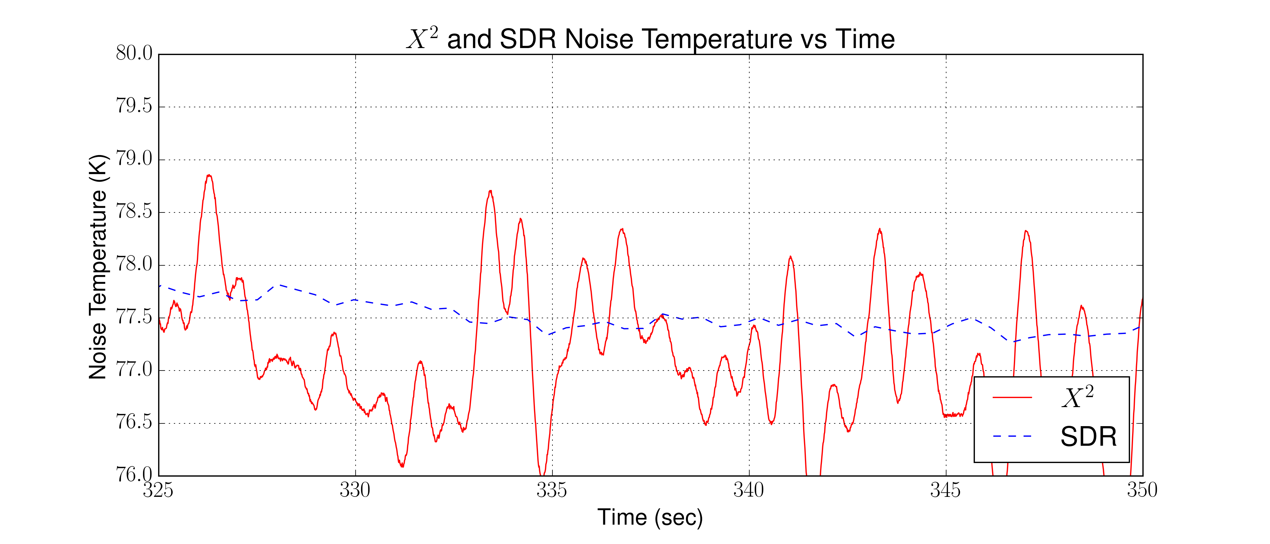
Extra Slides
Introduction
Related Works
Background
Implementation
Experimental Results
Example Usage Scenario
Closing
Difference between X² and SDR
In LN2 ~ .0003 Kelvin. | In Ice, ~ .002 Kelvin

Slide 40
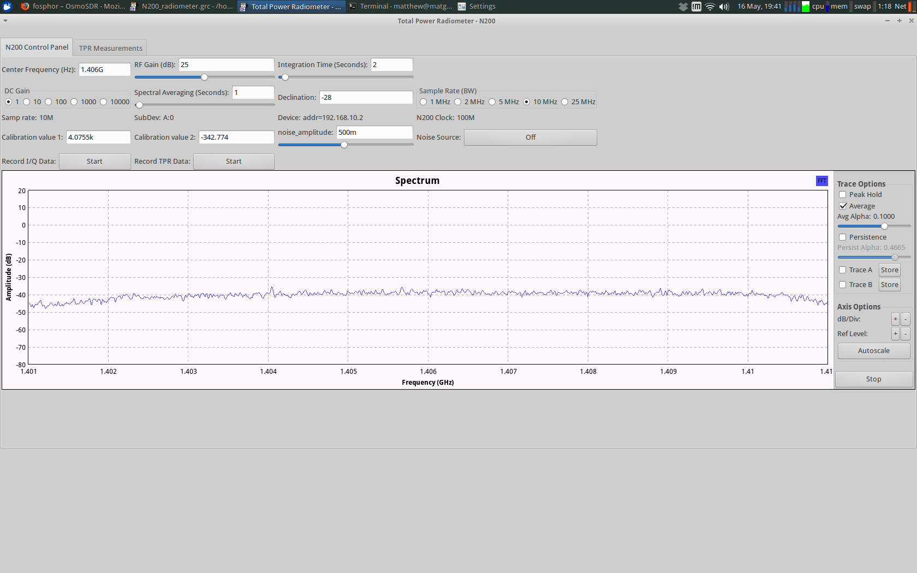
Extra Slides
Introduction
Related Works
Background
Implementation
Experimental Results
Example Usage Scenario
Closing
GUI Interface Full

Slide 41
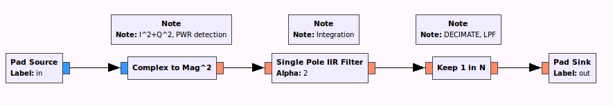
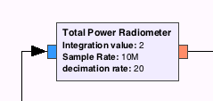
Extra Slides
Introduction
Related Works
Background
Implementation
Experimental Results
Example Usage Scenario
Closing
TPR Blocks in GNURadio
Power Detection
Integration
Low Pass Filter

Slide 42
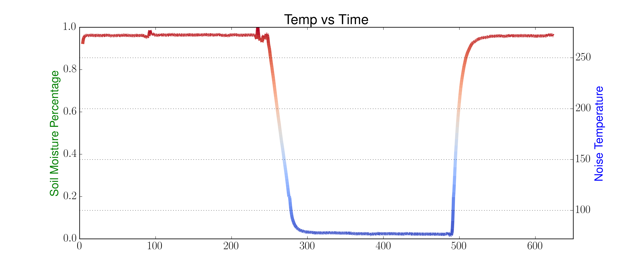
Extra Slides
Introduction
Related Works
Background
Implementation
Experimental Results
Example Usage Scenario
Closing
Soil Moisture Application

